Slide 1
Secondary Protein Structure
By: Mari Rosenwald and Skye Kelly

Slide 2

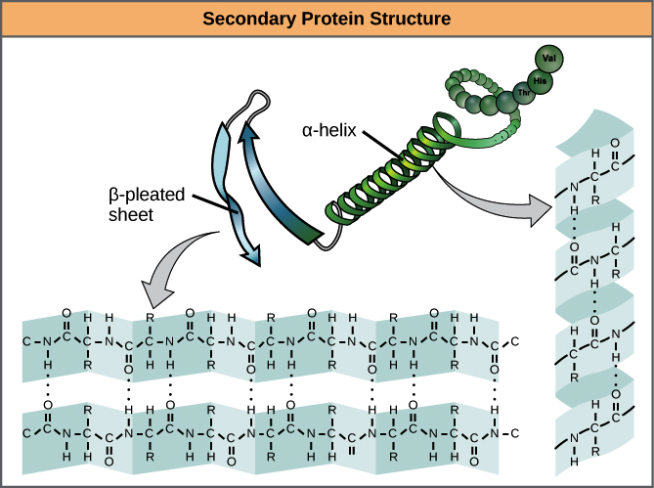
What is the secondary Structure of a protein?
The 3-D structure of a protein that forms due to the biochemistry in the amino acid chain.
This structure is created due to the hydrogen bonds between carboxyl groups on amino acids.

Slide 3
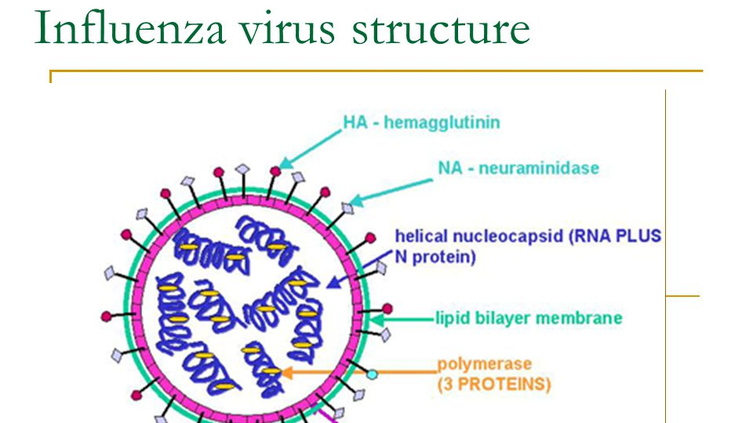

What did we test?
H1 influenza protein (Ha) found by Dr. Mike Doud from the Bloom Lab at Fred Hutch.

Slide 4

The amino acids with the highest RSA values will have a higher entropy.
A higher RSA (Relative Solvent Accessibility) value translates to a higher likeliness that an amino acid will be polar.
Amino acids with a higher preference will not change their polarity.

Slide 5
Preference Data
 | A | C | D | E | F | G | H | I | K | L | … | P | Q | R | S | T | V | W | Y | Site | wt
0 | 0.050522 | 0.292074 | 0.041984 | 0.069723 | 0.112054 | 0.070729 | 0.207317 | 0.172276 | 0.175882 | 0.170153 | ... | 0.095909 | 0.145664 | 0.068147 | 0.169200 | 0.216658 | 0.183667 | 0.070102 | 0.282156 | 1 | K
1 | 0.299156 | 0.092621 | 0.193645 | 0.147577 | 0.093380 | 0.048215 | 0.110770 | 0.303162 | 0.100233 | 0.172399 | ... | 0.130529 | 0.103289 | 0.232608 | 0.080003 | 0.153042 | 0.209860 | 0.049683 | 0.175782 | 2 | A
2 | 0.282239 | 0.054260 | 0.075008 | 0.115239 | 0.052471 | 0.070930 | 0.090155 | 0.078627 | 0.245923 | 0.158548 | ... | 0.086427 | 0.165511 | 0.145599 | 0.226275 | 0.227845 | 0.169360 | 0.081525 | 0.108752 | 3 | K
3 | 0.285097 | 0.571661 | 0.023748 | 0.078999 | 0.264428 | 0.101803 | 0.186965 | 0.092665 | 0.074159 | 0.344304 | ... | 0.042051 | 0.093530 | 0.064137 | 0.017293 | 0.103523 | 0.148757 | 0.218695 | 0.103401 | 4 | L
4 | 0.185255 | 0.157839 | 0.127189 | 0.069883 | 0.490540 | 0.035142 | 0.066323 | 0.136314 | 0.044657 | 0.525195 | ... | 0.071764 | 0.058580 | 0.098211 | 0.033002 | 0.051313 | 0.269358 | 0.093787 | 0.249184 | 5 | L

Slide 6
Calculated Entropy
 | Site | RSA | A | C | D | E | F | G | H | I | … | P | Q | R | S | T | V | W | Y | wt | Entropy
0 | 18 | 0.170984 | 0.031051 | 0.032774 | 0.066396 | 0.130986 | 0.077862 | 0.010545 | 0.230710 | 0.057492 | ... | 0.016166 | 0.196481 | 0.325941 | 0.336750 | 0.297381 | 0.198282 | 0.063771 | 0.161101 | T | 1.007952
1 | 19 | 0.168605 | 0.035575 | 0.074407 | 0.097060 | 0.050744 | 0.068674 | 0.030246 | 0.057919 | 1.135448 | ... | 0.131968 | 0.050284 | 0.059777 | 0.032668 | 0.205351 | 0.276241 | 0.083863 | 0.066269 | I | 0.859274
2 | 20 | 0.000000 | 0.057711 | 1.578429 | 0.123115 | 0.056940 | 0.157598 | 0.053046 | 0.048184 | 0.054634 | ... | 0.055079 | 0.060295 | 0.098218 | 0.047429 | 0.044885 | 0.062976 | 0.139656 | 0.110007 | C | 0.714210
3 | 21 | 0.077844 | 0.089144 | 0.100696 | 0.064763 | 0.094098 | 0.055839 | 0.038984 | 0.092634 | 1.469510 | ... | 0.039655 | 0.082291 | 0.039980 | 0.084321 | 0.099074 | 0.142382 | 0.103434 | 0.050375 | I | 0.766489
4 | 22 | 0.005076 | 0.058867 | 0.135161 | 0.138590 | 0.079870 | 0.056306 | 1.476877 | 0.061189 | 0.051963 | ... | 0.029653 | 0.079329 | 0.068681 | 0.084593 | 0.037853 | 0.149194 | 0.105167 | 0.064609 | G | 0.764519
Notes:
Found Entropy – how random it is (high entropy = less random)
Link code to this

Slide 7
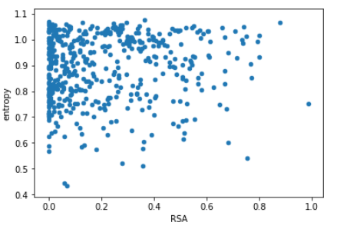
RSA vs. Entropy

Slide 8
Hypothesis 1
The data proved that our first hypothesis was incorrect.
The data supports a contrasting hypothesis. It supports the theory that amino acids' RSA values have little to no correlation to it’s entropy.

Slide 9
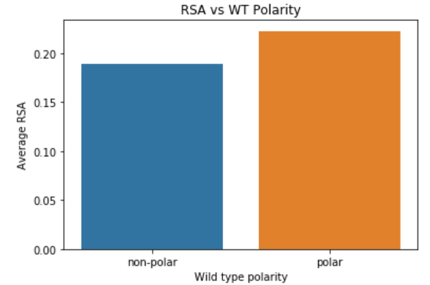
Average RSA vs. Polarity

Slide 10
Hypothesis 2
The data proved that our first hypothesis was correct.
The data supports the hypothesis that a high RSA value means that it has a higher likeliness of being polar.

Slide 11
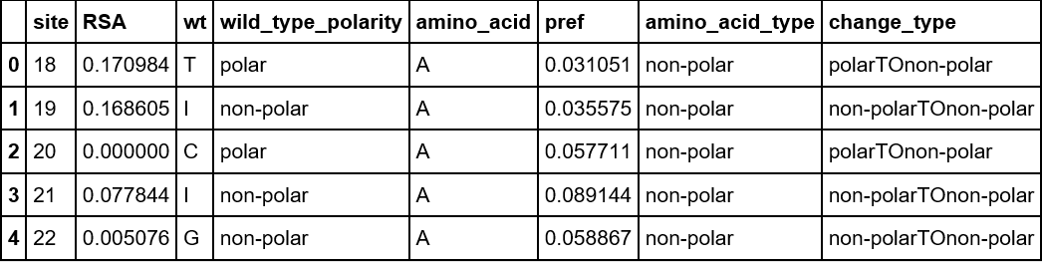
Polarity Type and Preference Table

Slide 12
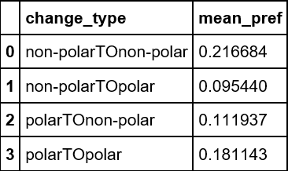
Change Type and Mean Preference Data

Slide 13
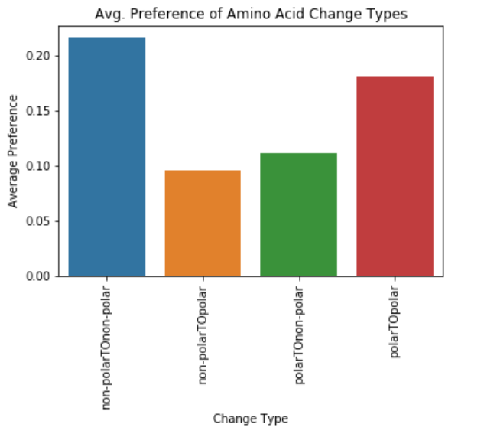
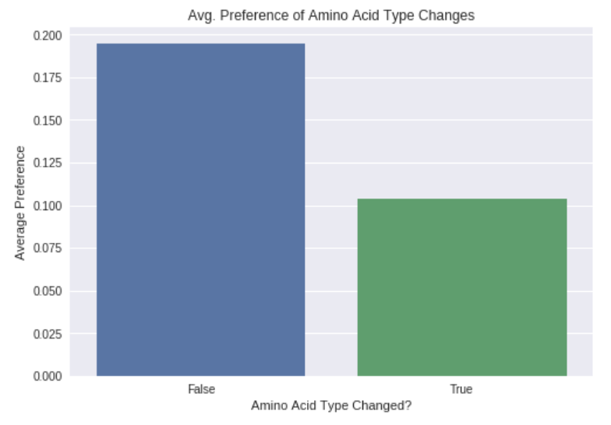
Change Type vs. Average Preference
Average Preference of Amino Acid Type Changes

Slide 14
Hypothesis 3
The data proved that our first hypothesis was correct.
The data supports our hypothesis that amino acids with a higher preference will not change their polarity.

Slide 15
Link to code!!!!
https://colab.research.google.com/github/hutch-gwc/science_fair/blob/master/final%20project-secondary%20protein%20structure.ipynb

